Slide 1
CS 4530 Software Engineering
Module 9: Distributed Systems Principles and Requirements
Jonathan Bell, Adeel Bhutta, Mitch Wand
Khoury College of Computer Sciences
© 2022, released under CC BY-SA

Slide 2
Learning Objectives for this Lesson
By the end of this lesson, you should be able to…
Describe 5 key goals of distributed systems
Understand the fundamental constraints of distributed systems
Understand the roles of replication and partitioning in the context of the DNS infrastructure

Slide 3
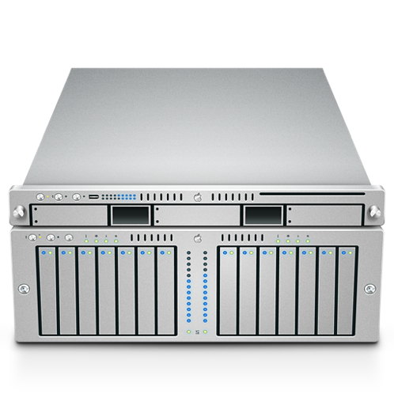
What is a distributed system?
Model:
Many servers talking through a network
Model:
Many servers and clients talking through a network
Notes:
First: some ground rules. What is a distributed system? Most apps that we work with are distributed in some way, at least in the sense that there is some code that runs in a client, and elsewhere on a server. For this and the following lesson, however, we’ll focus primarily on what happens when the server code needs to be distributed across multiple computers, with a network connecting them.

Slide 4
Distributed Systems Goals
Scalability
Performance
Latency
Availability
Fault Tolerance
“Distributed Systems for Fun and Profit”, Takada
Notes:
Why go through the effort of implementing, deploying and maintaining a distributed system? Here are the general goals a DS should address. We’ll look at a motivating example next, and then jump back to these goals to discuss them in greater details.
For now, it should suffice to recognize the most common reason for why a system needs to become distributed - Scale: be able to turn a knob and have “more” of the system - respond to more requests than otherwise possible

Slide 5
Example: Domain Name System (DNS)
Problem Statement
Nodes (hosts) on a network are identified by IP addresses
E.g.: 142.251.41.4
We humans prefer something easier to remember: calendar.google.com, facebook.com, www.khoury.northeastern.edu
We need to keep a directory of domain names and their addresses
We also need to make sure everybody gets directed to the correct host
Notes:
Our case study today will be the domain names system.
(Read slide)

Slide 6
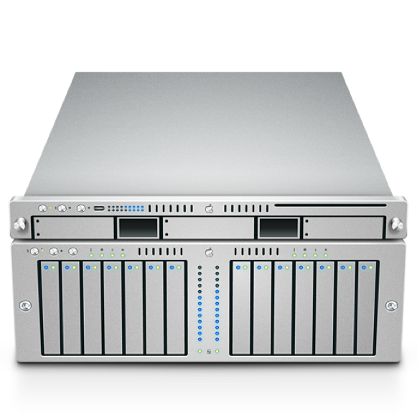
Example: Domain Name System (DNS)
Need to handle millions of DNS queries per second
Not immediately obvious how to scale: how do we maintain replication, some measure of consistency?
DNS Server
facebook.com?
31.13.66.35
Notes:
As just mentioned, a primary goal for needing to expand to distributed systems is scale. This is certainly true for DNS.
(Read slide)

Slide 7
Domain Name System
Strawman solution: Use a Local file
Keep local copy of mapping from all hosts to all IPs (e.g., /etc/hosts)
Hosts change IPs regularly: Download file frequently
Lot of constant internet bandwidth use
IPv4 space is now full
32-bits: 4,294,967,296 addresses
At 1 byte per address, file would be 4GB
Not a lot of disk space (now, DNS introduced in the late 80s)
Notes:
Before we get to the distributed solution, let’s examine a strawman solution. Keep a copy of all of DNS locally on each computer. Since IPs change regularly -> We can keep the file up to date by syncing it with a remote version.
(Read slide)

Slide 8
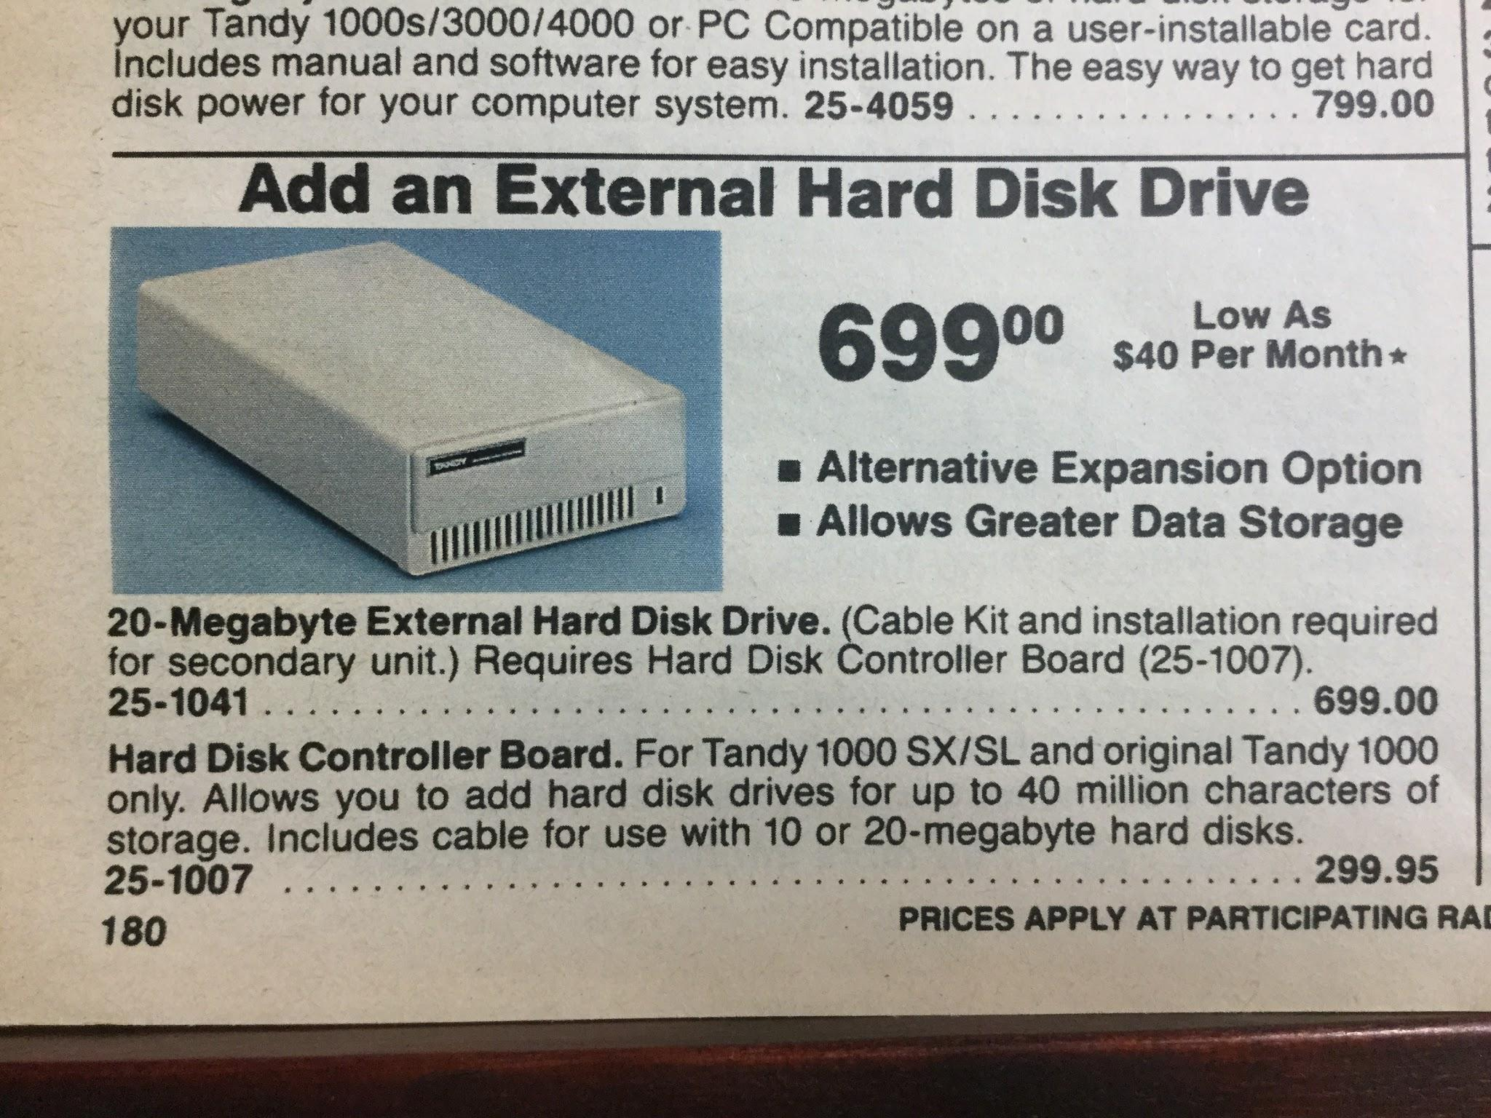
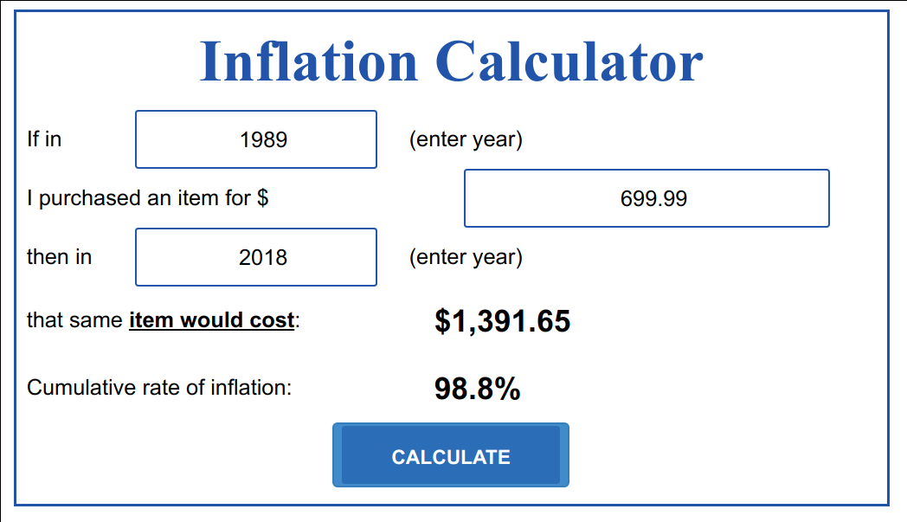
Domain Name System
Strawman solution: Use a Local file
Keep local copy of mapping from all hosts to all IPs (e.g., /etc/hosts)
Hosts change IPs regularly: Download file frequently
Lot of constant internet bandwidth use
IPv4 space is now full
32-bits: 4,294,967,296 addresses
At 1 byte per address, file would be 4GB
Not a lot of disk space (now, DNS introduced in the late 80s)
We need 200x of these to hold 4GB: $270K+
Notes:
The storage needed is not much of a problem from nowadays perspective, even if it is wasteful.
Ad from 1989

Slide 9
Domain Name System
Strawman solution: Use a Local file
Keep local copy of mapping from all hosts to all IPs (e.g., /etc/hosts)
Hosts change IPs regularly: Download file frequently
Lot of constant internet bandwidth use
IPv4 space is now full
32-bits: 4,294,967,296 addresses
At 1 byte per address, file would be 4GB
Not a lot of disk space (now, DNS introduced in the late 80s)
But a lot of constant internet bandwidth
More names than IPs
Aliases
Not scalable!
Notes:
We can conclude that this approach is not scalable. We need some design for our system where we can add more IP addresses, more names, and more kinds of records without the system exploding like this strawman does.

Slide 10
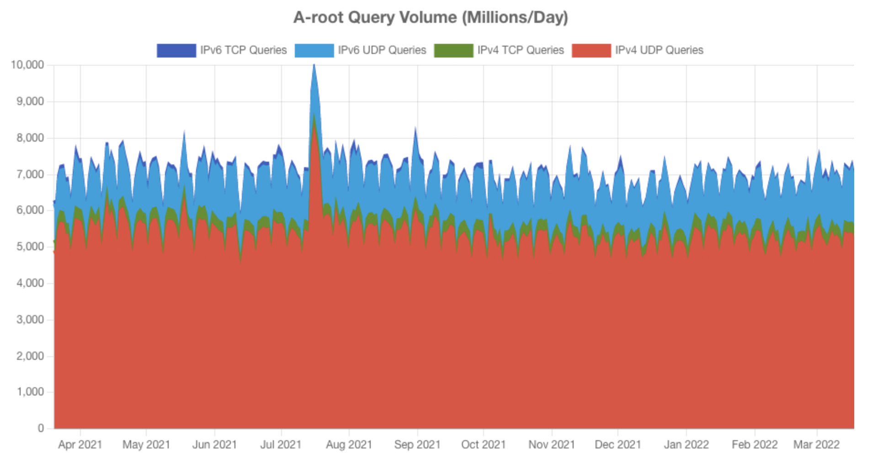
Domain Name System
Another Strawman: Well-known centralized server. All requests made to this server:
Single point of failure
Bottleneck for throughput and access time
Bottleneck for administration (adding/changing records?)
Ultimately, not scalable!
https://a.root-servers.org/metrics
Notes:
Here is another strawman: instead of having all of the DNS information replicated to every computer, we could have a single, well-known centralized server.
The graphic on the right shows a small portion of DNS traffic worldwide (less than 15% of all traffic, and only considering top-level .com traffic). It is quite a few queries per day - note that the graph is labeled in thousands, but those are really thousands of millions of requests per day (aka billions)
(Read slide)

Slide 11
DNS as a distributed system
We need a scalable solution
New hosts keep being added
Number of users increases
Need to maintain speed/responsiveness
We need our service to be available and fault tolerant
It is a crucial basic service
A problematic node shouldn’t “crash the internet”
Reads are more important that writes: far more queries to resolve records than to update them
Global in scope
Domain names mean the same thing everywhere
Notes:
It should now be increasingly apparent why DNS is a case study in distributed systems design. It is a system that must scale. As we will see, the *requirements* of a system will greatly influence our design choices. Here are the requirements for DNS:
(Read slide)

Slide 12
Distributed Systems Goals
“the ability of a system, network, or process, to handle a growing amount of work in a capable manner or its ability to be enlarged to accommodate that growth.”
Scalability
Performance
Latency
Availability
Fault Tolerance
“Distributed Systems for Fun and Profit”, Takada
Notes:
Let’s revisit the distributed systems goals, and see how we can design systems to address them, starting with scale.
Most things are easy to do small: Let’s make a system that lets 5 people run around a 2D map. Great! How do we let 100,000 people run around that same map? Uh-oh. A scalable system is one in which we can scale the resources available to the system up in a way that is hopefully sub-linear to the scale in demand for usage. If our software can’t be distributed over multiple computers, then we are limited in scale to the resources that a single large computer can provide. This is the case for DNS.

Slide 13
Distributed Systems Scale “Horizontally”
“Vertical” scaling: add more resources to existing server
Faster CPUs, more CPU cores, more RAM, more storage
Ineffective once: Clock speed plateaus; difficult to write applications that utilize 256 CPU cores (adding 2TB RAM to a server can often help)
“Horizontal” scaling: add more servers
Rely on “commodity” servers rather than state-of-the-art hardware
Allows for dynamic addition of resources as needed by load
Notes:
(Read slide)

Slide 14
Distributed Systems Goals
“is characterized by the amount of useful work accomplished by a computer system compared to the time and resources used.”
Scalability
Performance
Latency
Availability
Fault Tolerance
“Distributed Systems for Fun and Profit”, Takada
Notes:
Performance is measured perhaps by throughput (how much work gets done), but also utilization of resources (are we using an enormous amount of resources to achieve this throughput?)
(response time is latency, will get to that in a minute)

Slide 15
Improve Throughput With Concurrency
Throughput: total requests that can be processed per unit-time
Facebook.com
Request
Cache Check
Build friends list
Build Newsfeed
Build Suggestions
Send response
Response
Request
Facebook.com
Response
Cache Check
Build friends list
Build Newsfeed
Build Suggestions
Send response
Build friends list
Build Newsfeed
Build Suggestions
Notes:
Distributed systems can improve throughput through concurrency. If we can create a system that uses more machines to do more work concurrently, then we can satisfy more requests in the same amount of time.
The figure shows a way to (theoretically) double the throughput of a site like Facebook. Serving a request might require a few different key steps to occur. If we could perform those steps for different requests concurrently, we can increase our throughput.
Note that it is also worthwhile to note that we could implement the concurrency on a single node. But, eventually we will reach the limitations of how many things can be done at once on a single server - and then we will need to consider distributing the work to multiple nodes.

Slide 16
Distributed Systems Goals
“The state of being latent; delay, a period between the initiation of something and the it becoming visible.”
Scalability
Performance
Latency
Availability
Fault Tolerance
“Distributed Systems for Fun and Profit”, Takada
Notes:
Latency captures response time. How long does it take between a user making a request and receiving their response?

Slide 17
Latency: Delay in Receiving a Response
In client/server model, latency is simply: time between client sending request and receiving response
What contributes to latency?
Adding pipelined components -> latency is cumulative
Camera
Sends images
Image Service
Phase 1
Phase 2
10ns
5ns
5ns
10ns
Total latency: 30ns
Processes images
Notes:
In a client/server model, the latency is the time between the client sending a request and receiving a response.
How do we end up with latency? It is the sum total of all of the things that have to get done to get a response, including transmitting a request, that request transiting through a network/system, arriving at the destination, being processed, and then the response being sent, transmitted, received, and decoded.
With latency, each step in the pipeline of processing a request adds to the latency. In the example at the bottom of this slide, there are several steps to processing an image. The total latency is the sum of each delay.

Slide 18
Improving Latency with Distributed Systems
Often more challenging than increasing throughput
Examples:
Physical - Speed of light (network transmissions over long distances)
Algorithmic - Looking up an item in a hash table is limited by hash function
Economic - Adding more RAM gets expensive
Distributed systems can reduce latency by moving the data/server closer to the user
Notes:
(Read slide)

Slide 19
Networks Introduce Significant Latency
We still haven’t surpassed the speed of light: ~1 CPU cycle ~= 10cm of transmission distance
Chicago <-> NYC is a valuable link due to commodities markets in Chicago and equities markets in NYC
High frequency trading created a market for private, lower-latency alternatives to public internet
Extremely expensive, not a general solution (and still 8.5ms!)
https://www.zerohedge.com/news/chicago-new-york-and-back-85-milliseconds
Notes:
Distributed systems have the potential to reduce latency by moving data closer to users, but they also have the potential to increase latency due to the inherent physical limitations of the computer networks that connect them. (Read slide)
(How did we get to 10cm?)
What is the speed of light?
~300,000 km/sec
How fast does your CPU execute an instruction?
0.33 nanoseconds (say, 3Ghz CPU)
How far does light travel in 1 CPU cycle?
10 cm
How many instructions does your CPU execute in the time it takes light to travel from Chicago to NYC and back?
~700 miles -> 7.4msec -> 22 million instructions
Being in NYC would let me execute 22 million instructions in the time it took you to send your stock order to NYC and get a response!

Slide 20
Distributed Systems Goals
“the proportion of time a system is in a functioning condition. If a user cannot access the system, it is said to be unavailable.”
Scalability
Performance
Latency
Availability
Fault Tolerance
Availability = uptime / (uptime + downtime).
Often measured in “nines”
Availability % | Downtime/year
90% | >1 month
99% | < 4 days
99.9% | < 9 hours
99.99% | <1 hour
99.999% | 5 minutes
99.9999% | 31 seconds
“Distributed Systems for Fun and Profit”, Takada
Notes:
The next goal that we often try to achieve with distributed systems is availability - the proportion of time that a system is functioning.
It is hard to handle availability on a single machine. because we want redundancy. CLICK to show table we want to take a bunch of unreliable components and build a bigger thing that itself is reliable. what are the components and what kinds of redundancy can we provide?
Availability considers things more broadly than uptime though: what if there is a network outage? Without knowing every possible thing that can fail, instead, we might design for fault tolerance

Slide 21
Distributed Systems Challenges: Availability
More machines, more problems
Say there’s a 1% chance of having some hardware failure occur to a machine in a given month (power supply burns out, hard disk crashes, etc)
Now I have 10 machines
Probability(at least one fails during the month) = 1 - Probability(no machine fails) = 1-(1-.01)¹⁰ = 10%
100 machines -> 63% chance that at least one fails
200 machines -> 87% chance that at least one fails (!)
Implication: System as a whole must tolerate component failures
Notes:
(Read slide)

Slide 22
Distributed Systems Goals
“ability of a system to behave in a well-defined manner once faults occur”
Scalability
Performance
Latency
Availability
Fault Tolerance
What kind of faults?
Disks fail
Networking fails
Power supplies fail
Security breached
Datacenter goes offline
Power goes out
“Distributed Systems for Fun and Profit”, Takada
Notes:
Closely connected to availability is fault tolerance. If something bad happens, regardless of whether the system is temporarily unavailable, our system should eventually recover.
Anticipating all faults and failure modes is a challenge - several are listed here.

Slide 23
Distributed Systems Challenges: Performance, Availability
Number of nodes + distance between them
Notes:
What makes it difficult for us to achieve these goals?
An increase in the number of independent nodes may increase the need for communication between nodes (click) (reducing performance as scale increases)
And links can fail, too! (click). More links, higher probability of failure.

Slide 24
Challenge: Distributed Systems Rely on Networks
Can not expect network to be a perfect analog for communication within a single computer because:
Speed of light (1 foot/nanosecond)
Communication links exist in uncontrolled/hostile environments
Communication links may be bandwidth limited (tough to reach even 100MB/sec)
In contrast to a single computer, where:
Distances are measured in mm, not feet
Physical concerns can be addressed all at once
Bandwidth is plentiful (easily GB/sec)
Notes:
(Read slide)

Slide 25
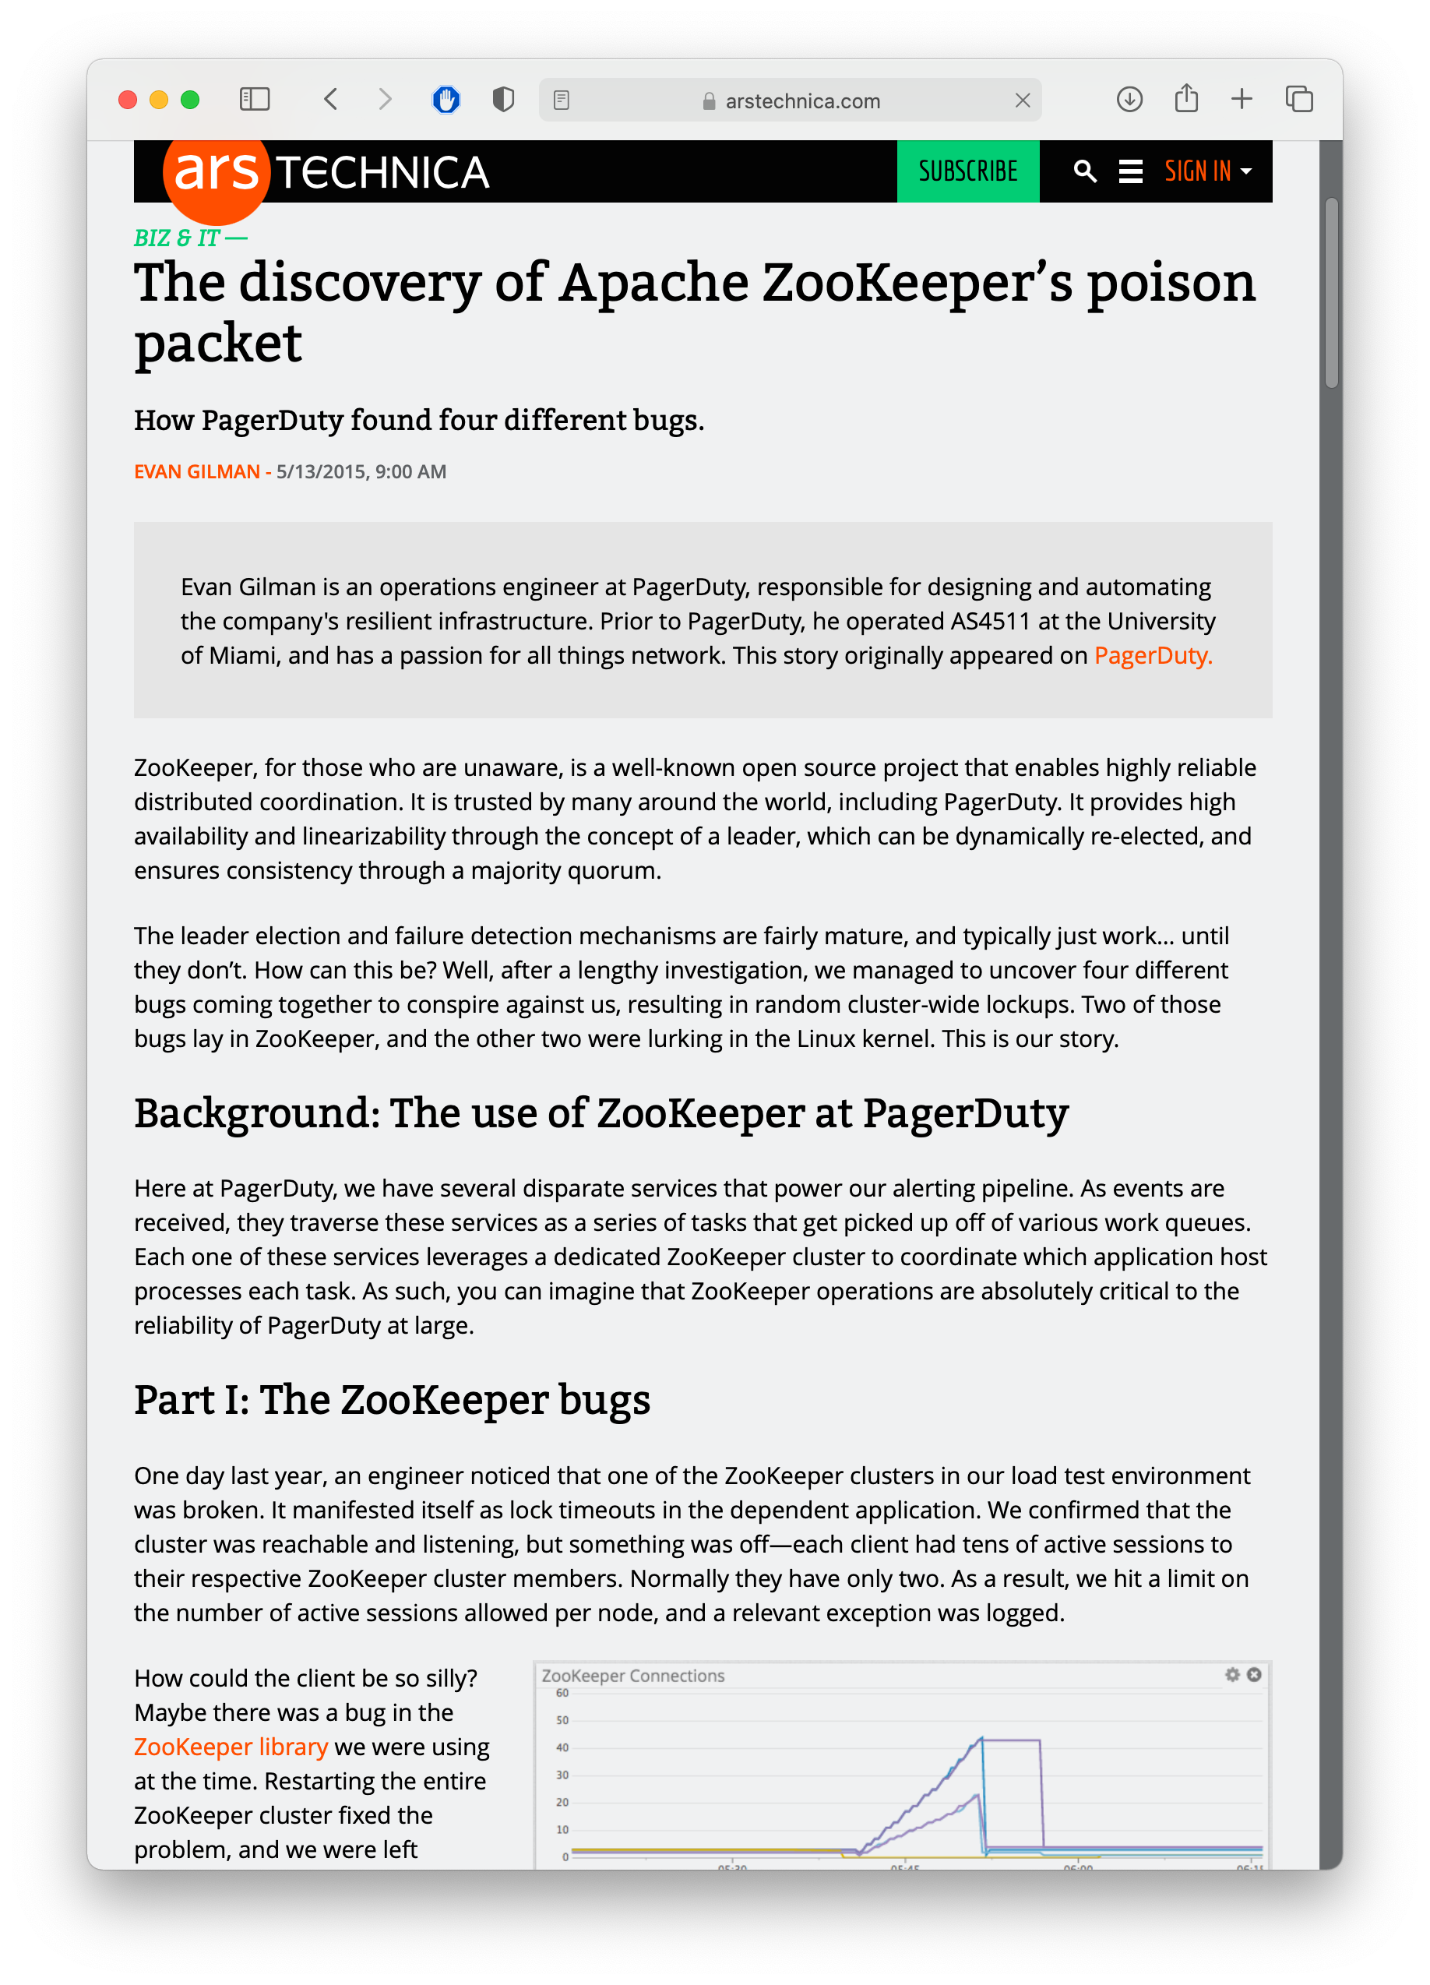
More challenges:
Networks still fail, intermittently and for prolonged periods

Slide 26
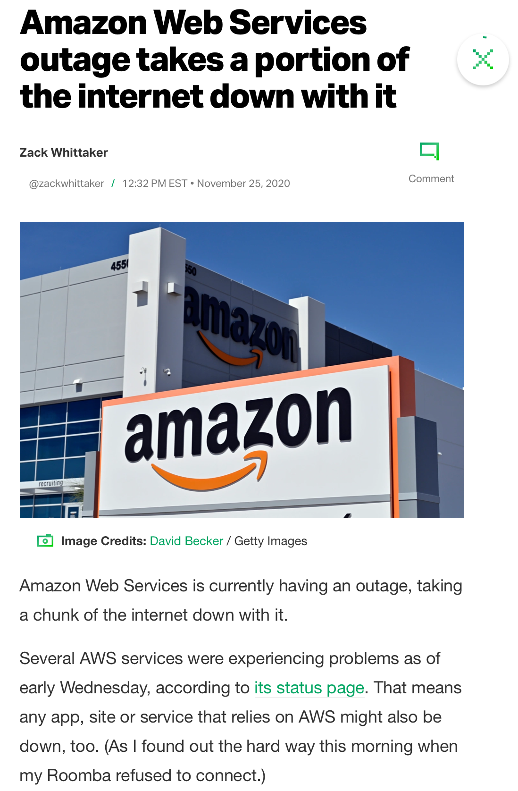
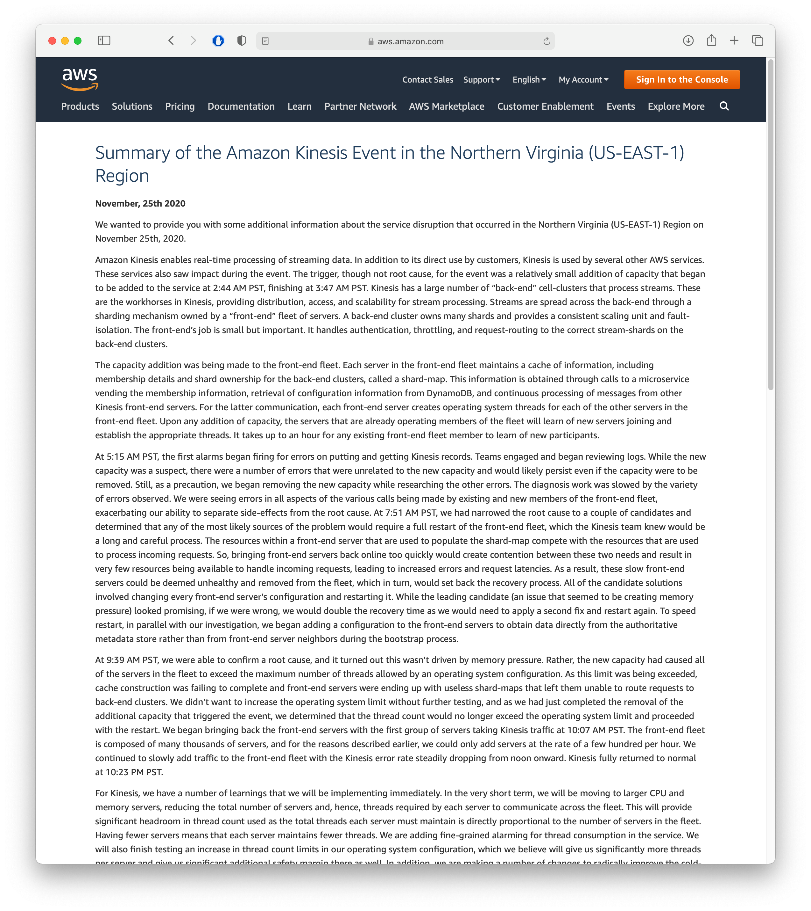
And still more challenges
We still rely on other administrators, who are not infallible
Notes:
It is also important to understand that there are even more challenges once we introduce a network, because we become reliant on other administrators and organizations to provide us with an essential service.

Slide 27
System Design Follows Requirements
Domain Name System
DNS requirements for querying records:
Scalability - grow in number of names
Performance - grow in number of requests
Latency - provide answers with little delay
Fault tolerance & availability - always provide a response
DNS requirements for updating/creating records:
Latency - OK if it takes minutes/hours for an update to take full effect
Performance - Expect far fewer writes than reads
Notes:
OK, with this review of stated goals in mind, let’s get back to the requirements for DNS, how they map to these goals, and then get into the design of DNS.
(Read slide)

Slide 28
Preliminary Design: How to organize data in the system?
This depends to a large degree on whether there is shared state
Usually, there is some shared state
How important is it to synchronize?
What about our DNS example?
Domains can be split (e.g., .com, .edu, .info, .eu, .jp, …)
Huge volume of requests – multiple nodes need to provide the same mappings, consistently
Notes:
(Read slide)

Slide 29
How to organize DNS
Idea: break apart responsibility for each part of a domain name (zone) to a different group of servers
Root servers
com
org
net
edu
uk
jp
bu
northeastern
mit
khoury
Each zone is a continuous section of name space
Each zone has an associate set of name servers

Slide 30
How to organize DNS
Idea: break apart responsibility for each part of a domain name (zone) to a different group of servers
Root servers
com
org
net
edu
uk
jp
In other words, we partition the domain names according to the top-level domain.
bu
northeastern
mit
khoury
Each zone is a continuous section of name space
Each zone has an associate set of name servers

Slide 31
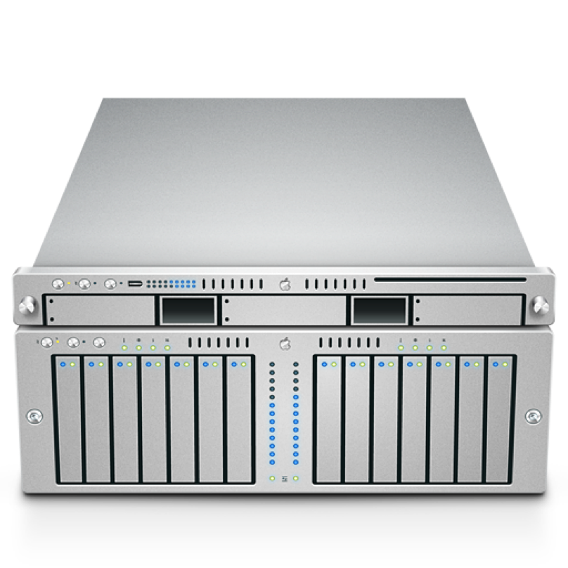
Recurring Solution #1: Partitioning
Partitioning is a common strategy to distributing a system and its data
Starting from a non-distributed system:
All accesses go to single server
A
B
Notes:
Partitioning is the simplest strategy that we can employ to improve the scalability of our system. Here is a system that allows the user to retrieve two kinds of data, which we call A and B. This is the non-distributed version, in which all accesses go to a single server.

Slide 32
Recurring Solution #1: Partitioning
Divide data up in some (hopefully logical) way
Makes it easier to process data concurrently (cheaper reads)
Each server has 50% of data, limits amount of processing per server.
Even if 1 server goes down, still have 50% of the data online.
A
[0…100]
B [A…N]
A
[101.. 200]
B [O…Z]
Notes:
With partitioning, we divide up data in some (hopefully logical) way. Deciding how to split this data into partitions can be a tricky problem. One easy way to do this is to use some property of the data: if we have 200 records, and they are indexed from 0… 200, you could envision putting the first 100 on one server, and the next 200 on another. Or, split student records by last name: A..N on one server and O..Z on another.
This can improve scalability because we can now process more requests concurrently: each server holds some subset of our data, and if clients want to touch different pieces of that dataset, they can interact with different machines. Even if one server goes down, the rest of the data would still be available.

Slide 33
Partitioning DNS
Root Servers
Global
Layer
net
org
edu
com
gov
uk
Administrational
Layer
root-servers
northeastern
www
www
khoury
Managerial
Layer
www
Notes:
DNS partitions responsibility by “layers”. In this simplified view, we show a single server responsible for each layer. In practice, each layer might be its own distributed system!
Let’s see how this partitioning is useful in an example that demonstrates how to resolve a name to an address (on next slide)

Slide 34
DNS: Example
What might a request look like in practice?
Root
Local DNS Server
course.khoury.neu.edu
course.khoury.neu.edu
ns.edu
.edu
129.10.117.35
course.khoury.neu.edu
ns1.neu.edu
course.khoury.neu.edu
neu.edu
129.10.117.35
ns1.khoury.neu.edu
129.10.117.35
course.khoury.neu.edu
khoury.neu.edu
Notes:
Here is a request for ‘course.khoury.neu.edu’. The request goes to the local DNS server, which asks its root server for the IP address. The Root server replies: “go ask the server for .edu”.
So the local server asks the server for .edu . The .edu server says “go ask the server for .neu”. And so on, until the local server asks the server for .khoury.neu.edu, which knows the address for course.khoury.neu.edu, and sends it to the local server, which tells it to the nice blue machine that was originally asking for it.

Slide 35
How to deal with volume?
We successfully distributed requests following the hierarchical nature of domain names
However, e.g., .com is a very popular TLD – there might be (hundreds of) thousands of requests happening at any given time
We may need several nodes just servicing .com
This leads to replication
Notes:
(Read slide)

Slide 36
Recurring Solution #2: Replication
Goal: Any node should be able to process any request
Again, starting from a non-distributed system:
All accesses go to single server
A
B
Notes:
The other recurring solution employed in distributed systems is replication: where we take our service, and take all of that data

Slide 37
Recurring Solution #2: Replication
Entire data set is copied
A
B
A
B
Notes:
And replicate it to multiple servers. In this model, our entire service (and all of the data) is replicated across multiple servers. Ideally, either server can process any request. Hence, we can increase the fault tolerance and performance of our system by having multiple machines that can process requests concurrently, and if one fails, the other can continue to process requests. We can even use this scheme to reduce latency, by placing these replicas in geographically diverse areas. If our replica is physically closer to a client, then it will take less time for a request to get to our server, and a response to get back to the client.

Slide 38
Recurring Solution #2: Replication
Improves performance:
Client load can be evenly shared between servers
Reduces latency: can place copies of data nearer to clients
Improves availability:
One replica fails, still can serve all requests from other replicas

Slide 39
Replication in DNS – Root Servers
Verisign, Inc. | a
Information Sciences Institute | b
Cogent Communications | c
University of Maryland | d
NASA Ames Research Center | e
Internet Systems Consortium, Inc. | f
U.S. DOD Network Information Center | g
U.S. Army Research Lab | h
Netnod | i
Verisign, Inc. | j
RIPE NCC | k
ICANN | l
WIDE Project | m
13 root servers
[a-m].root-servers.org
E.g., d.root-servers.org
Handled by 12 distinct entities
(“a” and “j”) are both Verisign
Don’t ask why.

Slide 40
There is replication even within the root servers
13 root servers
[a-m].root-servers.org
E.g., d.root-servers.org
But each root server has multiple copies of the database, which need to be kept in sync.
Somewhere around 1500 replicas in total.

Slide 41
Partitioning + Replication
So, DNS combines both partitioning and replication
As do most distributed systems
A
A
B
B
Notes:
Of course, most distributed systems combine both partitioning and replication

Slide 42
Replication Problem: Consistency
We probably want our system to work like this
Set A=5
“OK”!
Read A
“5”!
A
B
A
B
6
5
7
6
5
7
Notes:
Replication introduces a new problem, which is: consistency.
Consistency means that all nodes in a replicated system see the same data at the same time. When we set A to 5, the 5 appears on all of the replicas at once.

Slide 43
Sequential Consistency
AKA: Behaves like a single machine would
Set A=5
“OK”!
Read A
“5”!
Set A=5
A
B
A
B
“OK!”
6
5
7
6
5
7
Notes:
How do we implement replication? Let’s see the classic protocol for replicated data between two machines, and maintaining sequential consistency. Sequential consistency is a fancy way of saying, effectively, that clients can read and write data as if they were interacting with a single server, rather than multiple. The property that we need to guarantee is that before we acknowledge the update to 5, we need to ensure that it’s acknowledged by all machines. A simplification of this protocol, then, is: we provisionally update the value to 5, ask the replica to update it, and only once the replica acknowledge the update, we acknowledge it too. Future reads are then guaranteed to see that new value.
We achieved consistency.

Slide 44
Availability
If at least one node is online, can we still answer a request?
Read A
Set A=5
Set A=5
A
B
A
B
5
6
7
6
7
Notes:
Availability means that a failed node does not prevent survivors from continuing to operate.
If a replicated node goes down, we can still answer requests by rerouting to the live nodes.

Slide 45
Consistent + Available
On timeout, assume node is crashed
Read A
Set A=5
“OK”!
“5”!
Set A=5
Assume replica failed
A
B
A
B
6
5
7
6
7
Notes:
We can ensure consistency and availability at the same time. If we detect that a node is down, we complete the update operation and reroute requests to the live nodes.

Slide 46
What if the network fails?
Set A=5
“OK”!
Read A
“6”!
Set A=5
Assume replica failed
A
B
A
B
6
5
7
6
7
Notes:
However what if the connection between the updated node and the replica fails? This is an assumption that we need to keep (our system must tolerate network partition)
Here, we fail to share the updated state, timeout occurs, but the replica is still up and servicing requests.
If we still want to service requests, we assume the replica is down and continue, prioritizing availability and losing consistency.
We could prioritize consistency, but then we would have to stop servicing requests, losing availability.

Slide 47
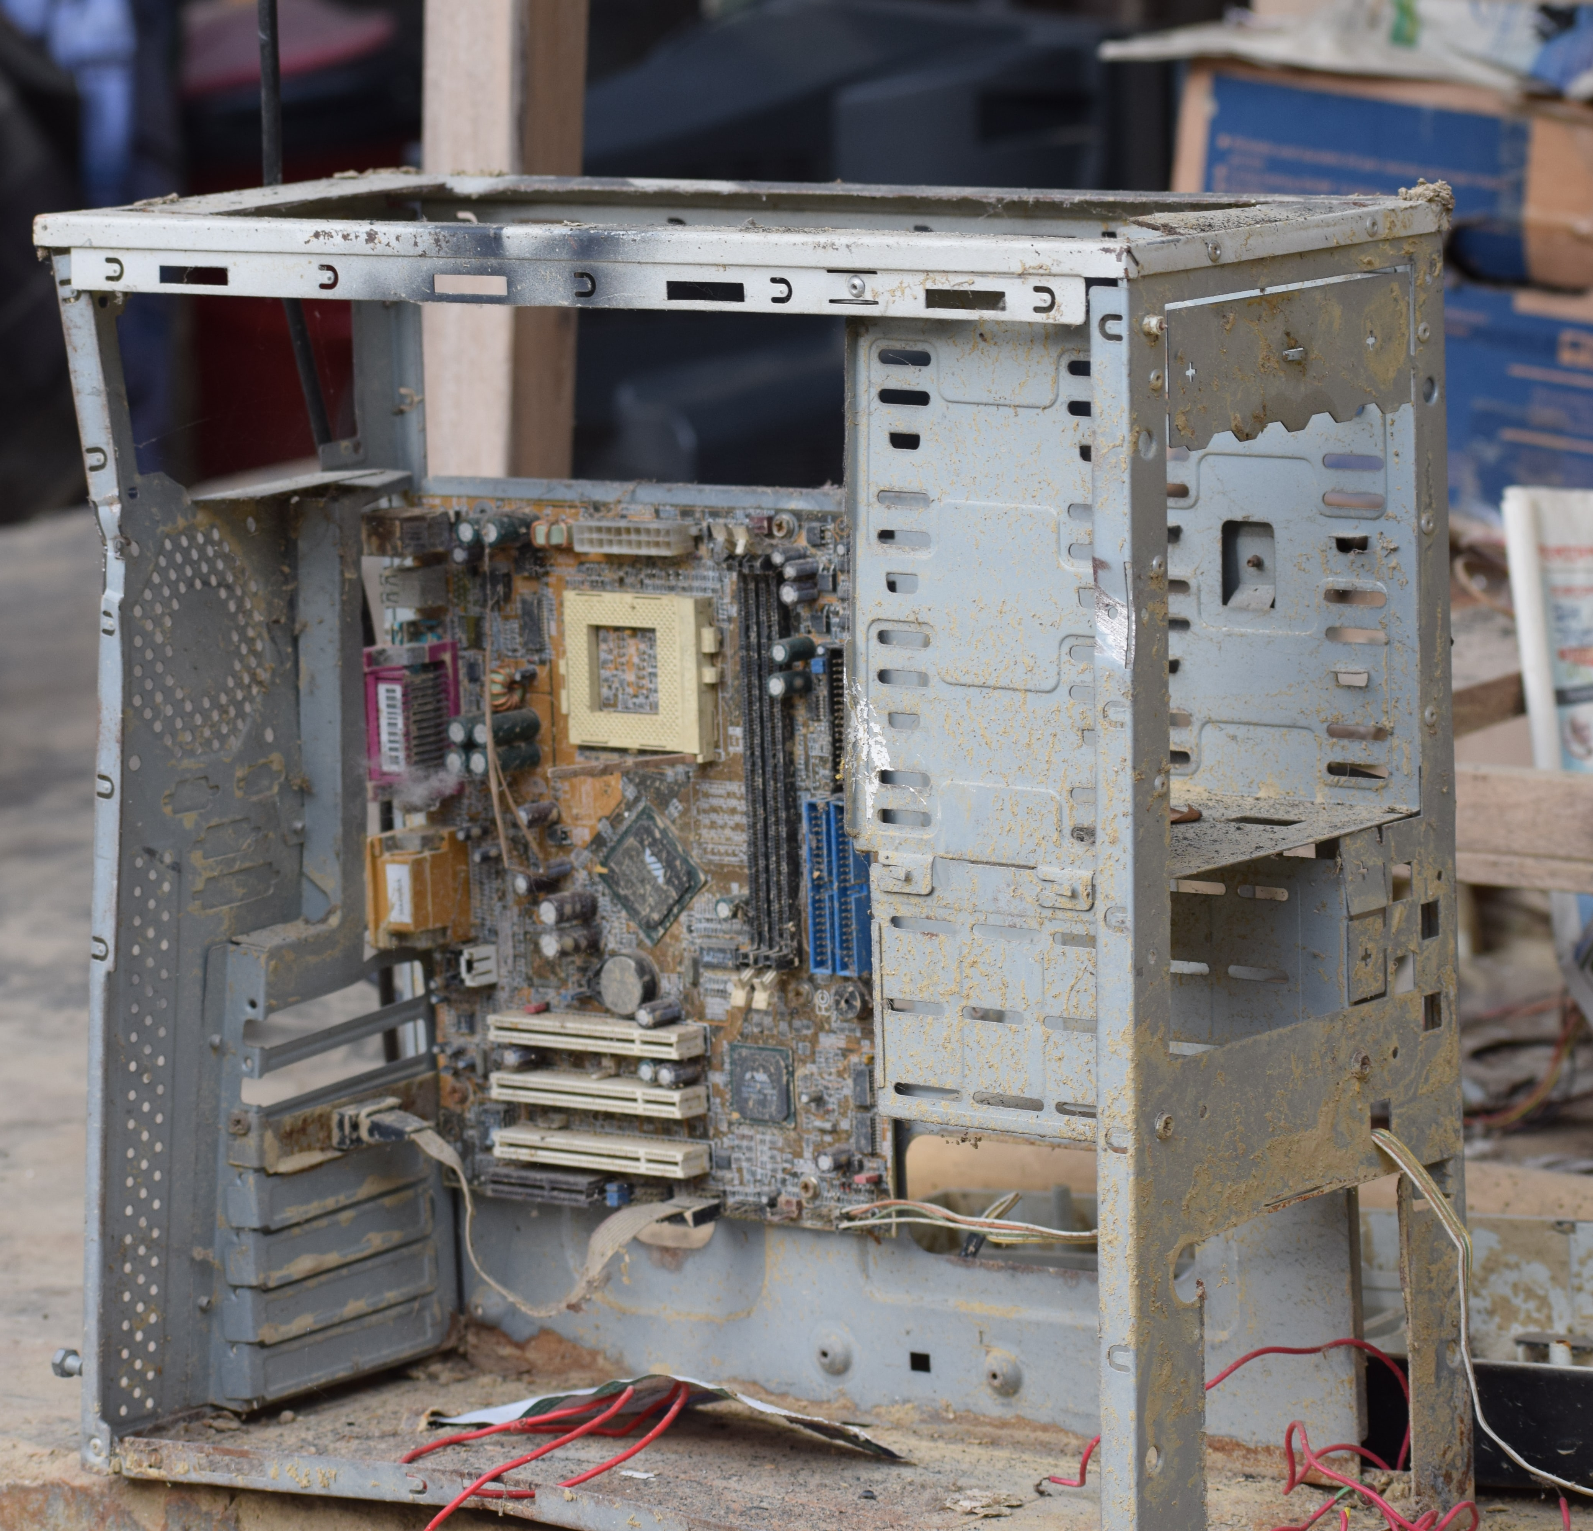
Shared Fate
Are you still there?
Two methods/threads/processes running on the same computer generally have shared fate [Crashed/not]
When two machines in a distributed system can’t talk to each other, how do we know if the other is crashed?
We call this a split brain problem

Slide 48
CAP Theorem: Consistency or Availability
Pick two of three:
Consistency: All nodes see the same data at the same time (strong consistency)
Availability: Individual node failures do not prevent survivors from continuing to operate
Partition tolerance: The system continues to operate despite message loss (from network and/or node failure)
Can’t drop this for a DS - networks can always fail
Notes:
Emphasize: If we want strong consistency, we won’t be able to achieve the availability we might want

Slide 49
DNS uses a relaxed consistency model
Recall - DNS requirements for updating/creating records:
Latency - OK if it takes minutes/hours for an update to take full effect
Performance - Expect far fewer writes than reads
DNS does not attempt to provide strong consistency
Updates are made in a best-effort approach
OK for clients to see the “old” value for a short time after it was updated

Slide 50
Distributed Software Engineering Abstractions
Key Question: Consistency vs Availability
Distributed system will never match exact semantics of non-distributed system
For replication do we value more: guaranteed consistency (looks like a single machine) or guaranteed availability (sometimes read stale data)?
For a lock server?
For the order of tweets on twitter?
For partitioning: Where can we draw the line? How do we determine how to organize the partitions?
Next module: common architectures for distributed systems

Slide 51
Review: Learning Objectives for this Lesson
By the end of this lesson, you should be able to…
Describe 5 key goals of distributed systems
Understand the fundamental constraints of distributed systems
Understand the roles of replication and partitioning in the context of the DNS infrastructure

